Slide 1
Linear Regression Sydney Traffic
Olivia Ross

Slide 2
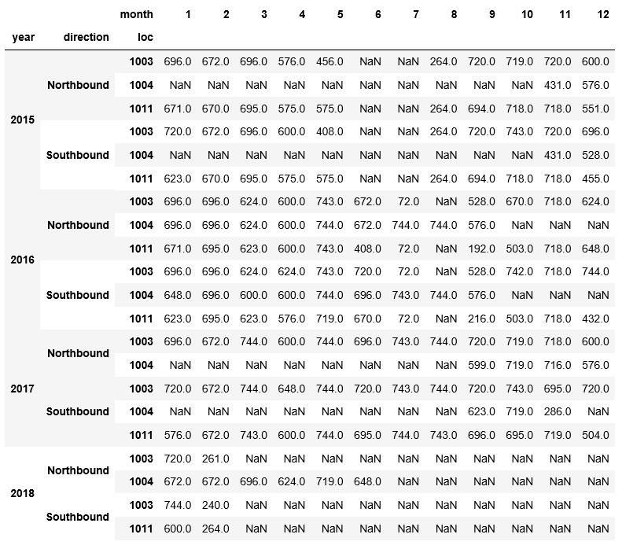
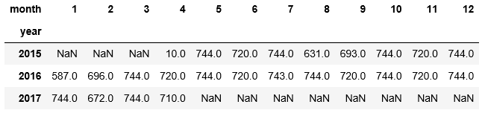
Available data from RMS
Available data from BOM
To make comparisons for traffic, it was essential to take the data only when all three stations were operating:
The Harbour Tunnel
The Cahill Expressway
The Western Distributor
Otherwise we would not know if cars were diverting to one of the other roads instead of taking the road we have measurements for.
Interestingly, there is no public traffic data for the harbour bridge itself. This would be convenient, as this data cannot capture any cars that divert themselves to York St.

Slide 3
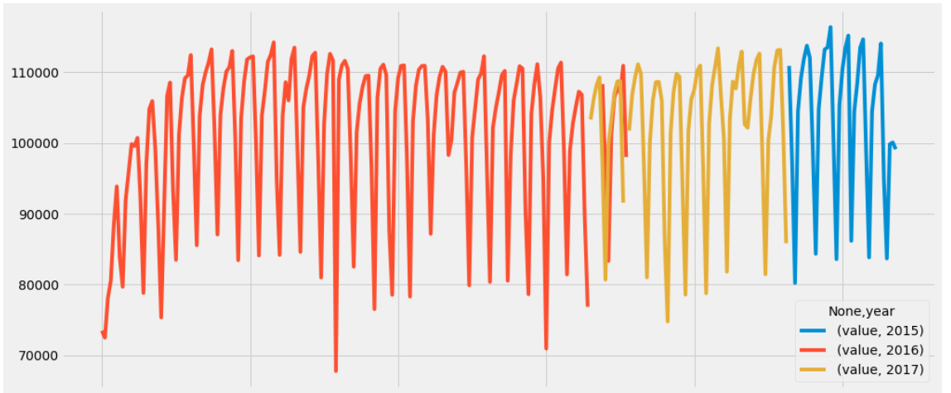
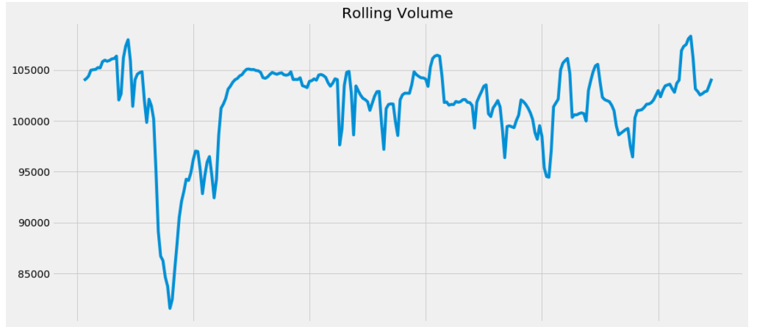
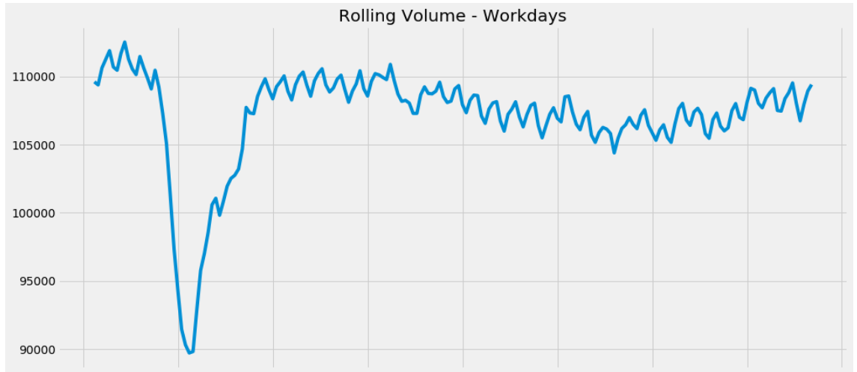
Is this data better as a timeseries?
The large dip in December and January 2015/16 is in the data.
It may be true and be seasonal. Unfortunately there is no other January data for comparison.

Slide 4
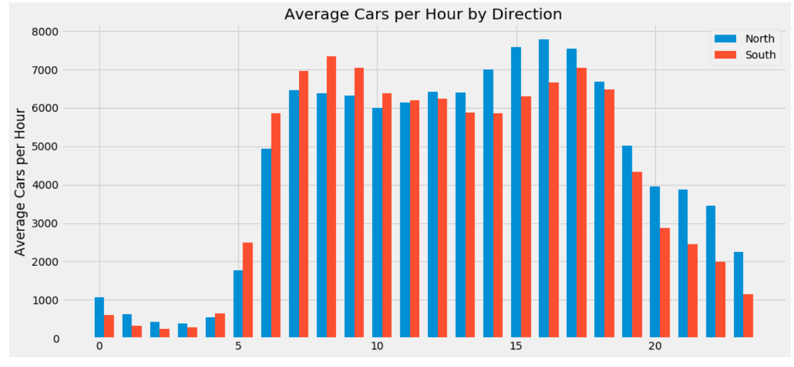
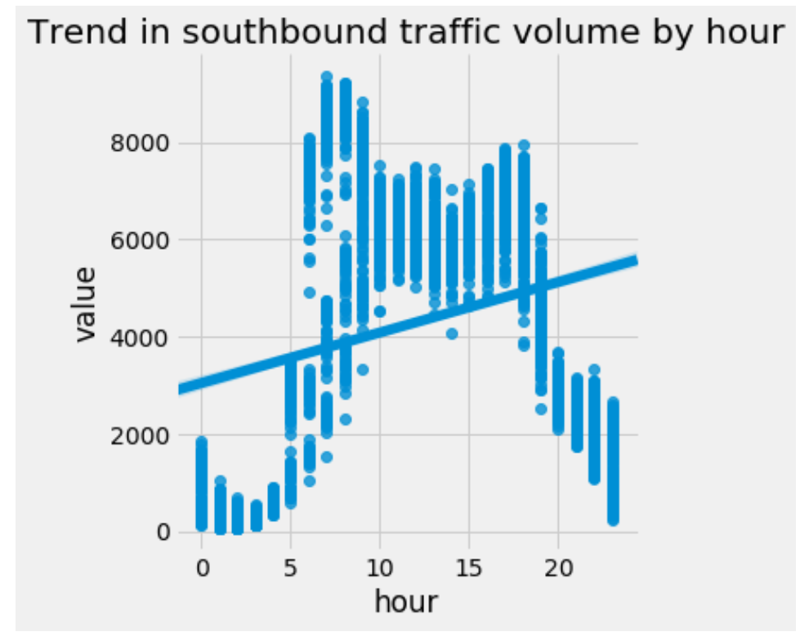
This shows the aggregate cars per hour over the entire merged dataset.

Slide 5
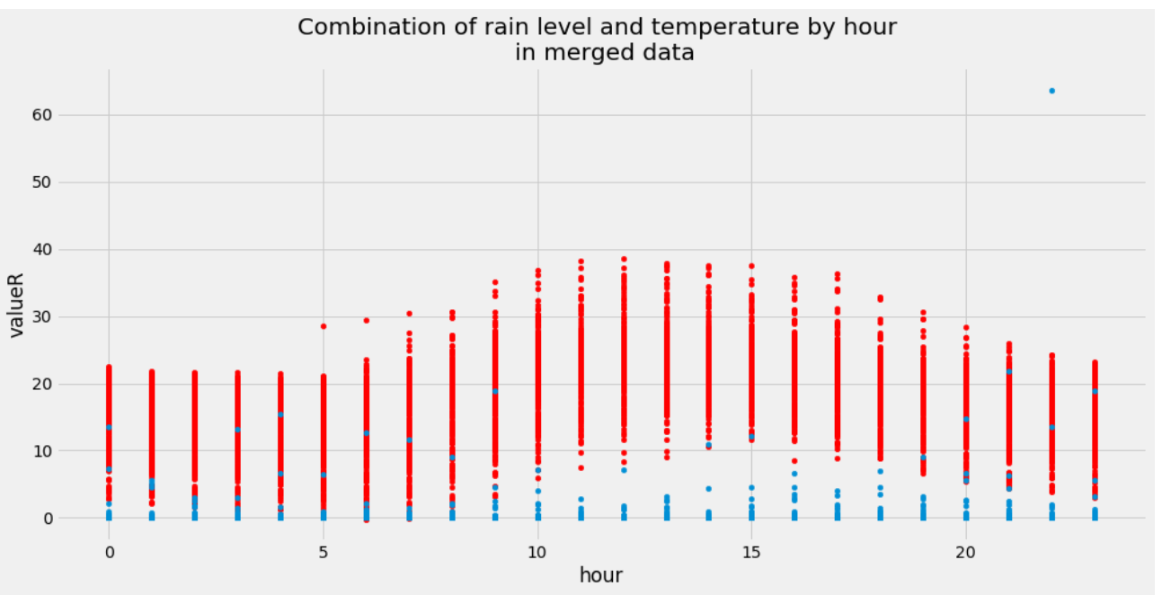
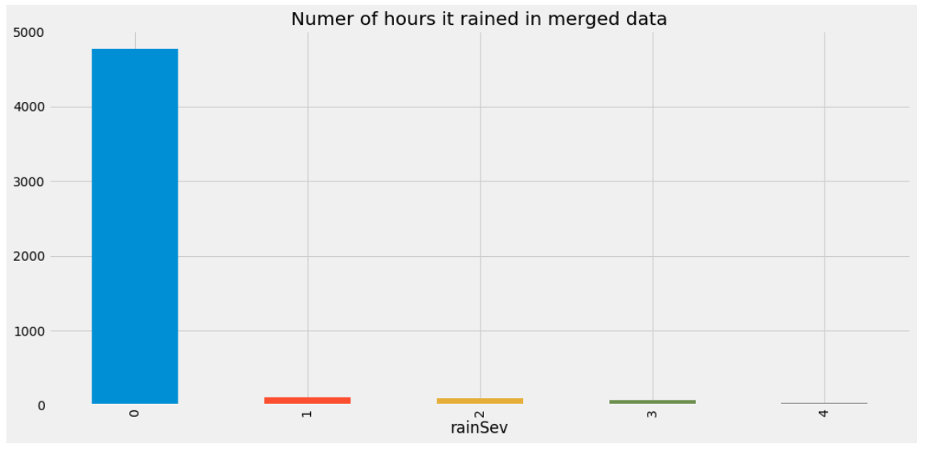
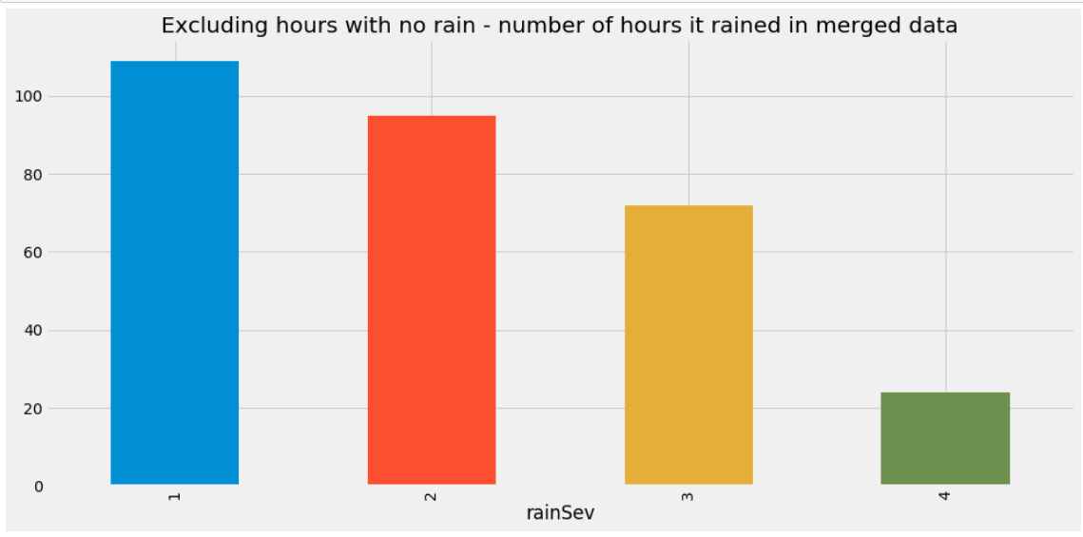
The vast majority of the time, it is not raining in Sydney.

Slide 6
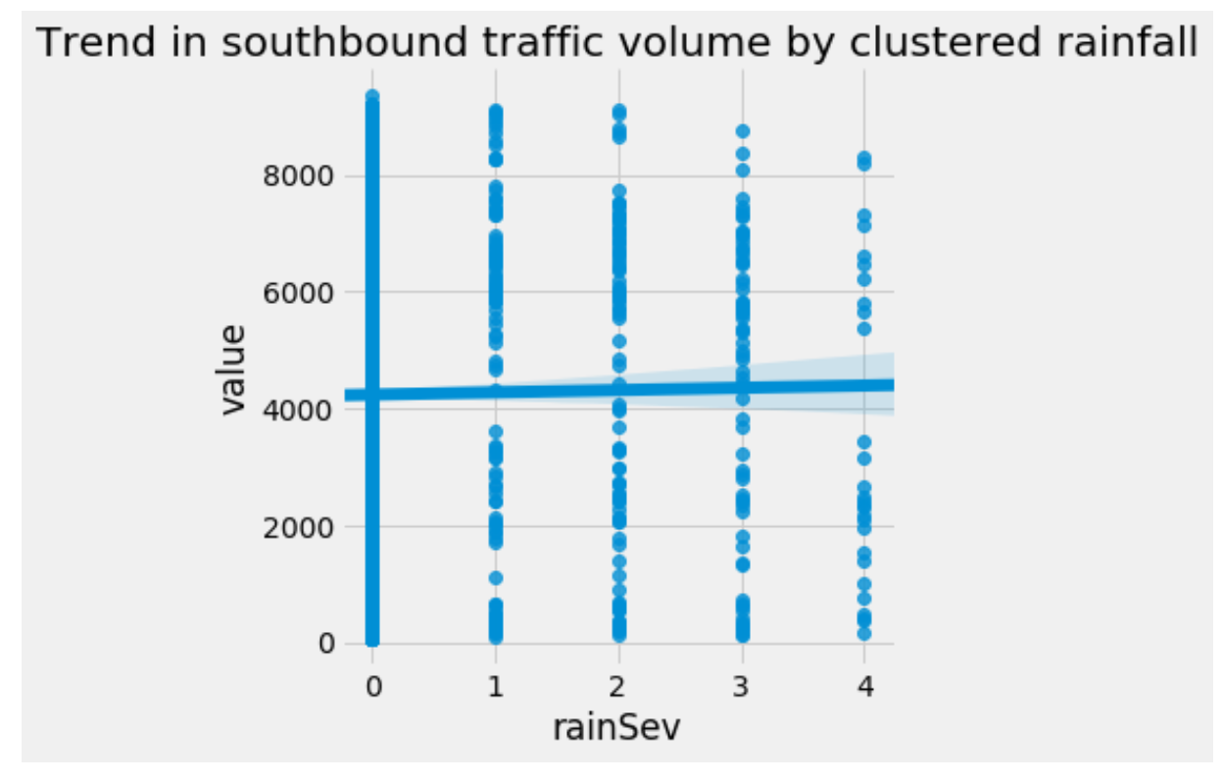
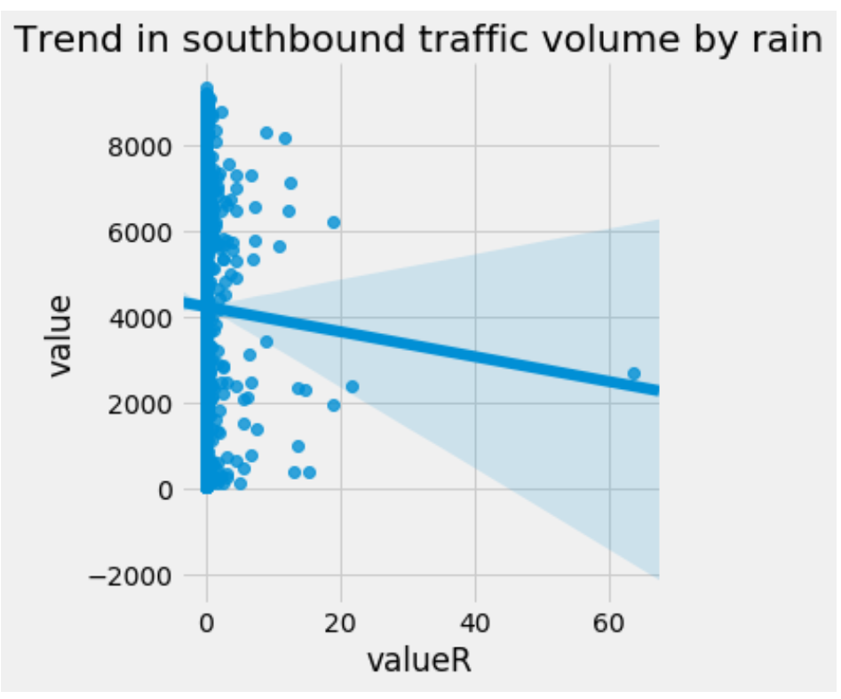
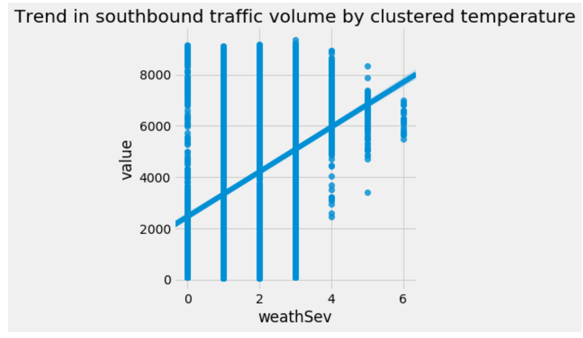
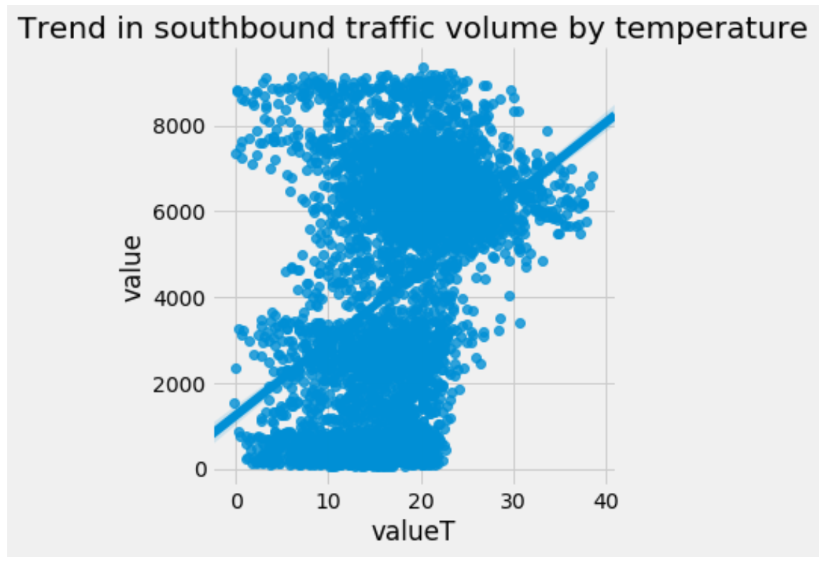
LM Plots showing the value of clustering the rain data.
An increase in temperature shows an increase in volume, regardless of clustering

Slide 7
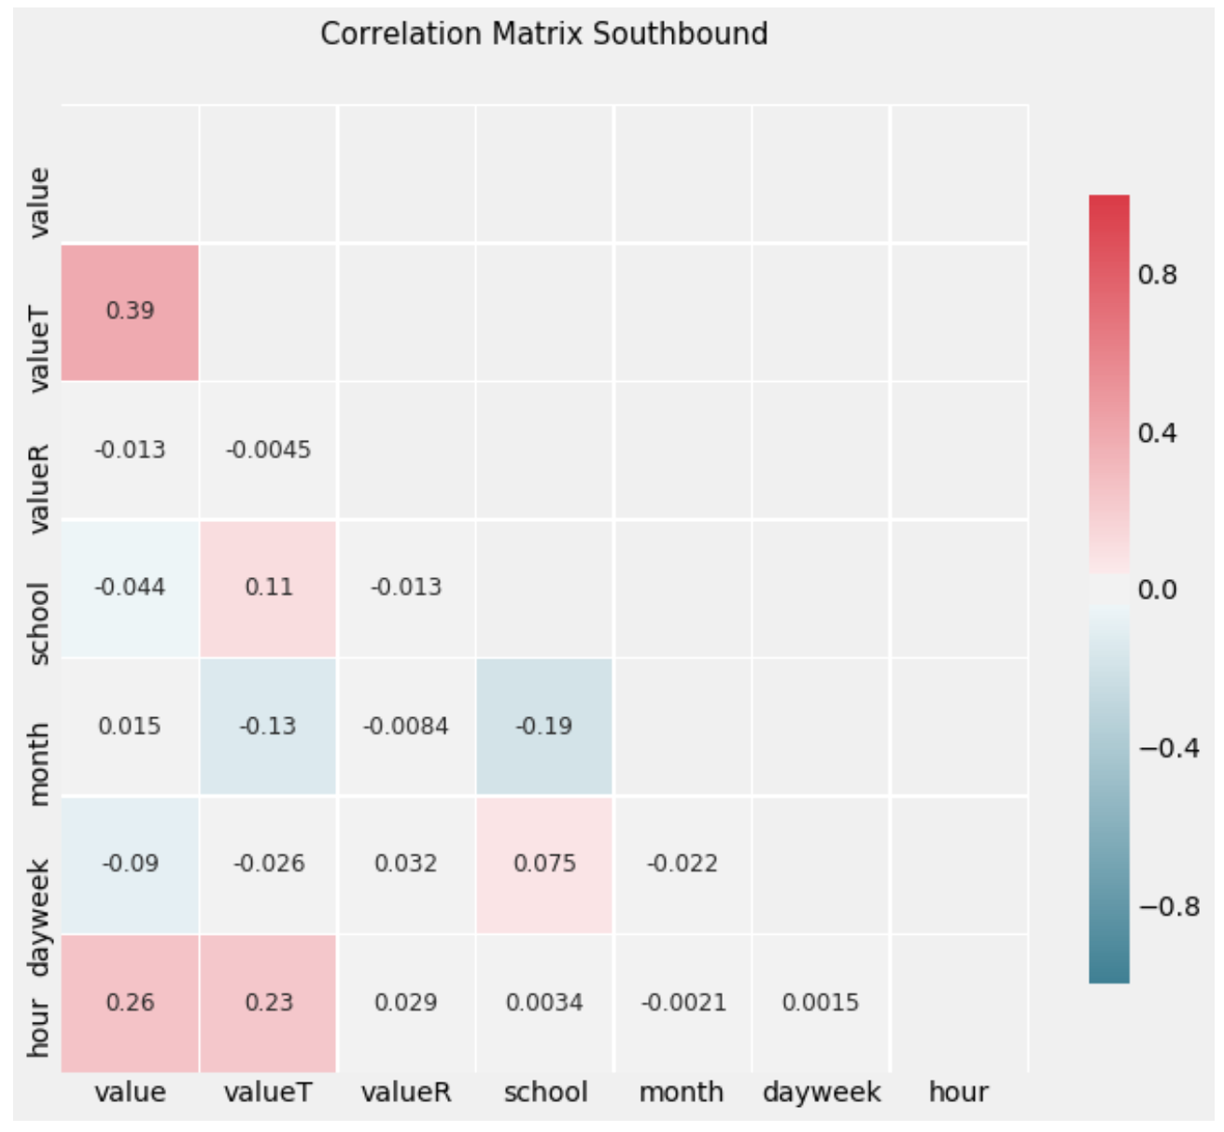
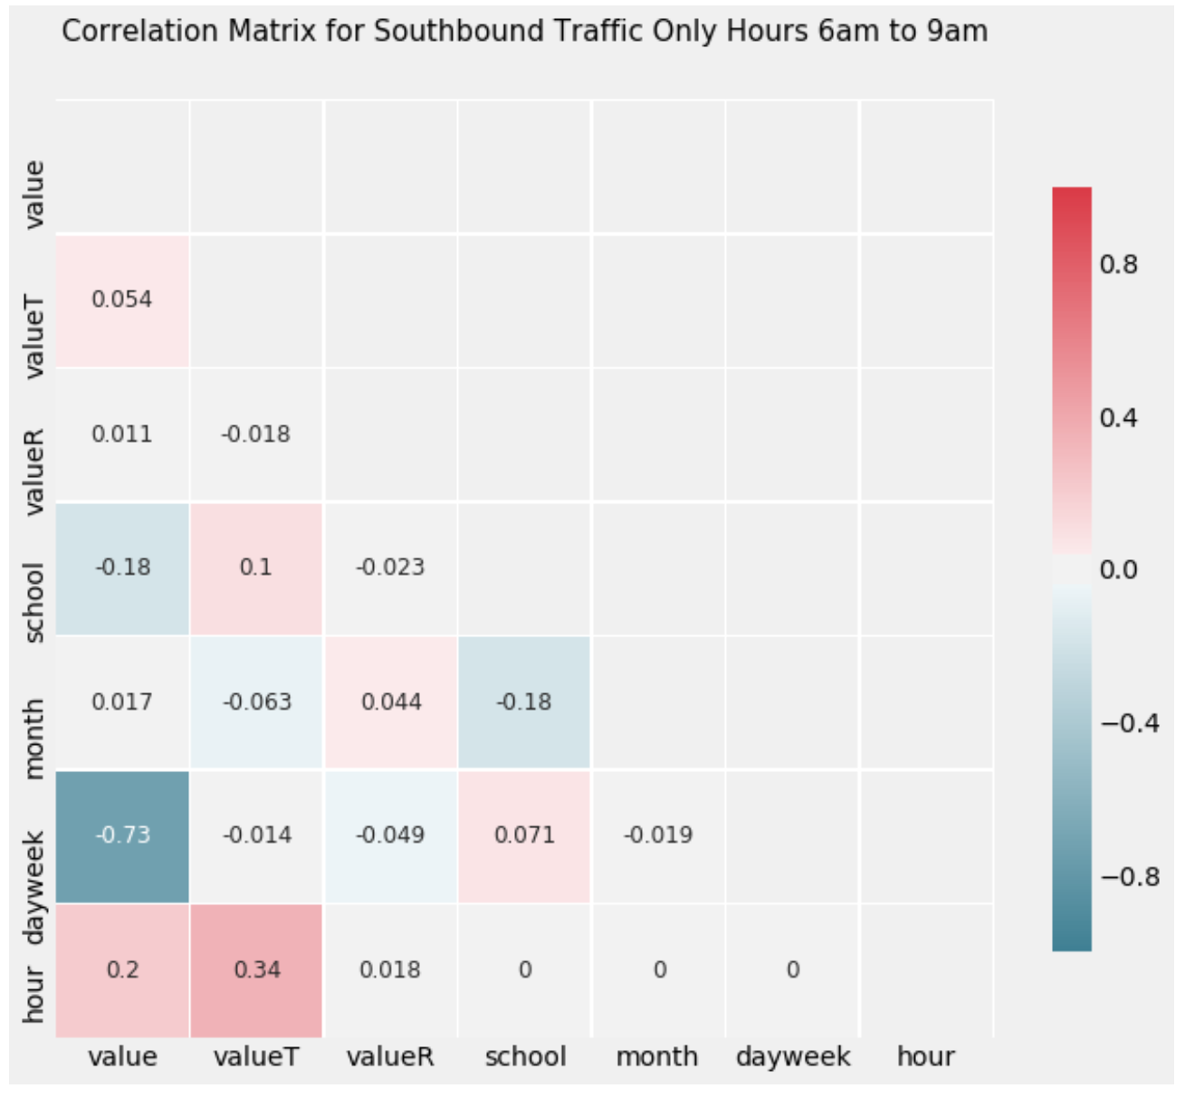
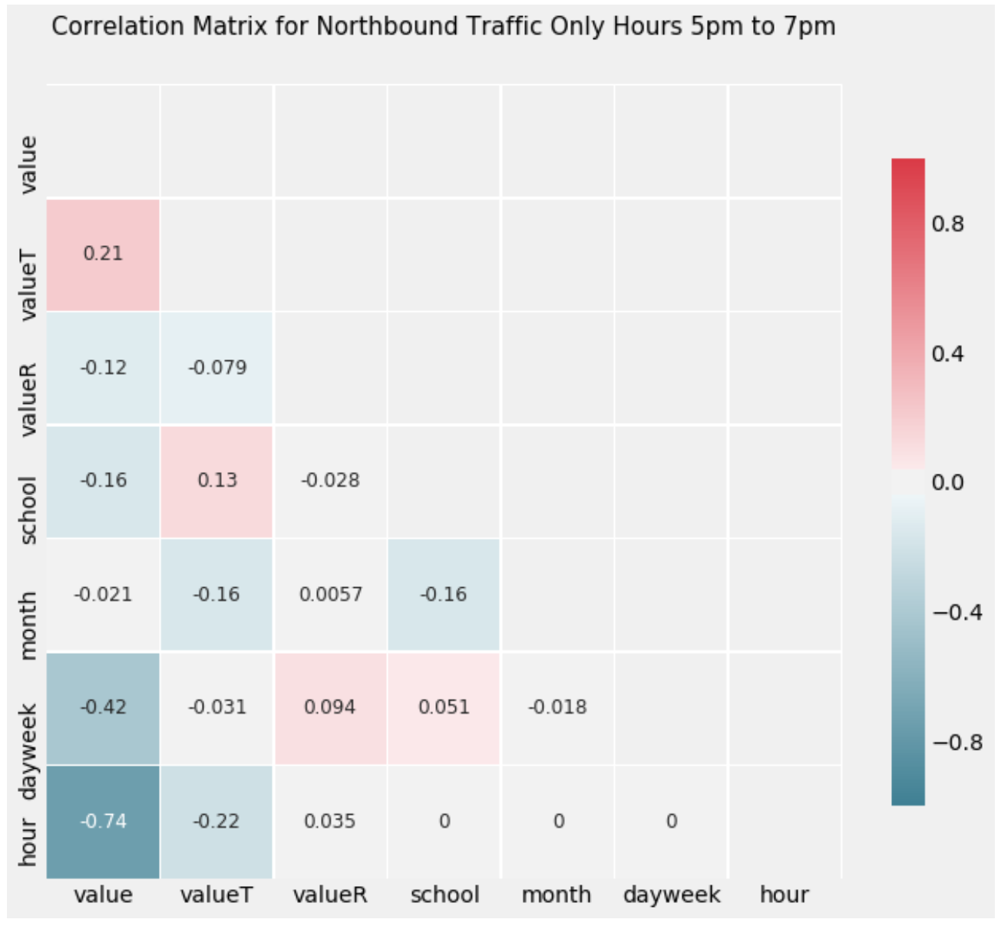
Temperature is more closely correlated over the entire 24 hours.
Restricting by time makes the day of the week more influential.

Slide 8
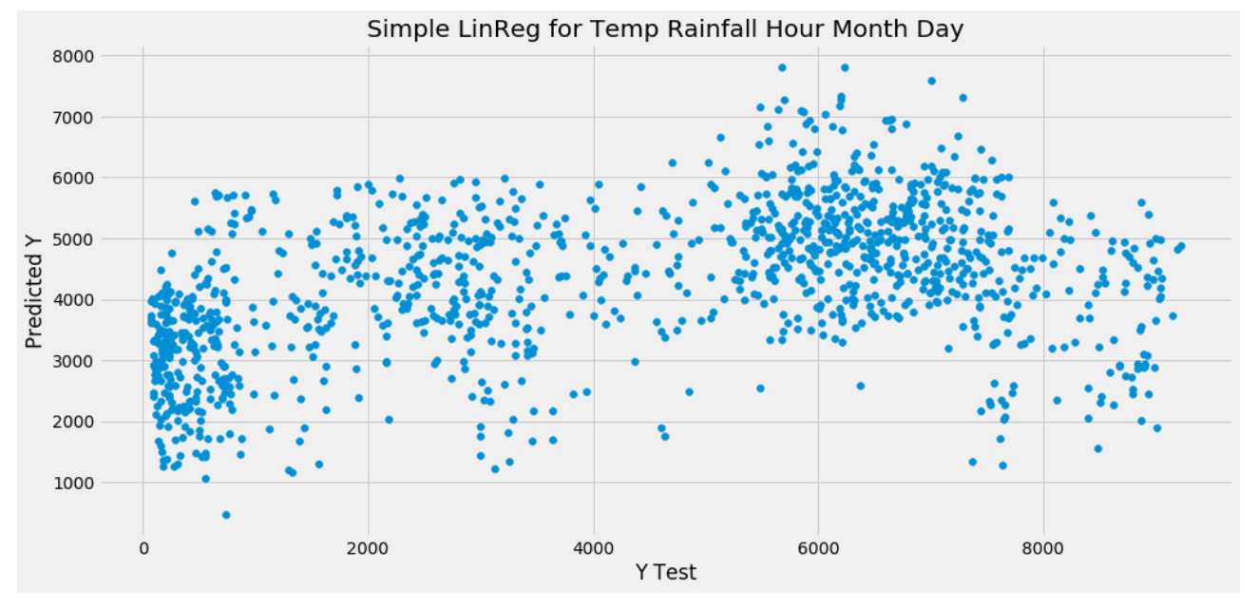
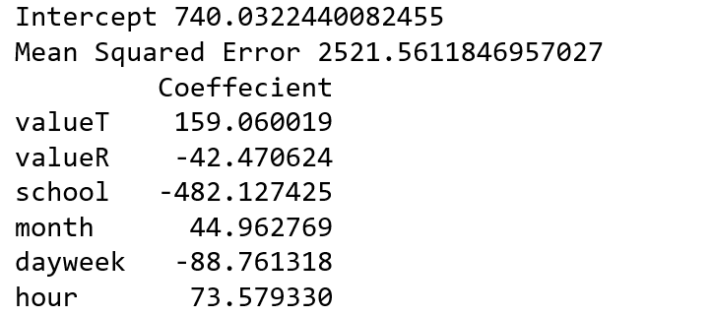
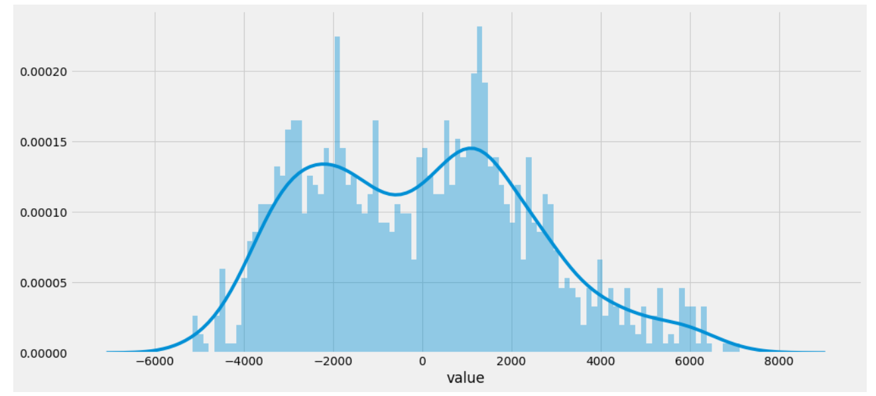
Simple linear regression with a large MSE, and a not-normal error residual distribution.

Slide 9
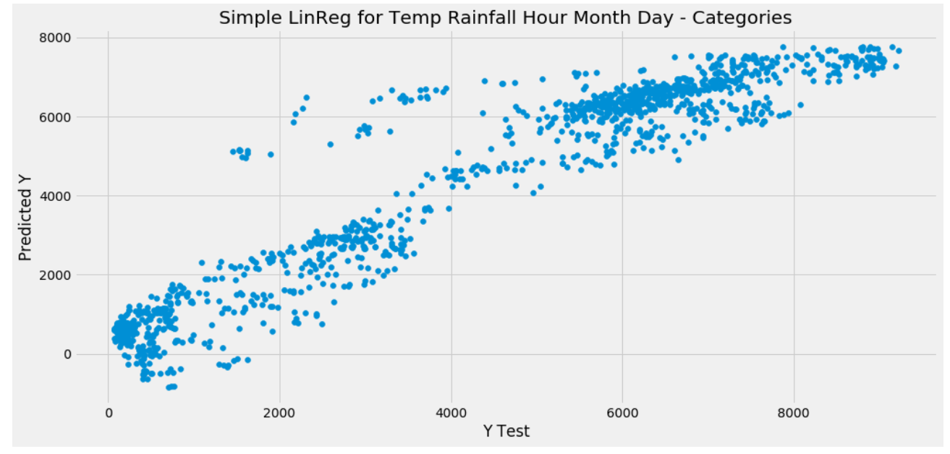
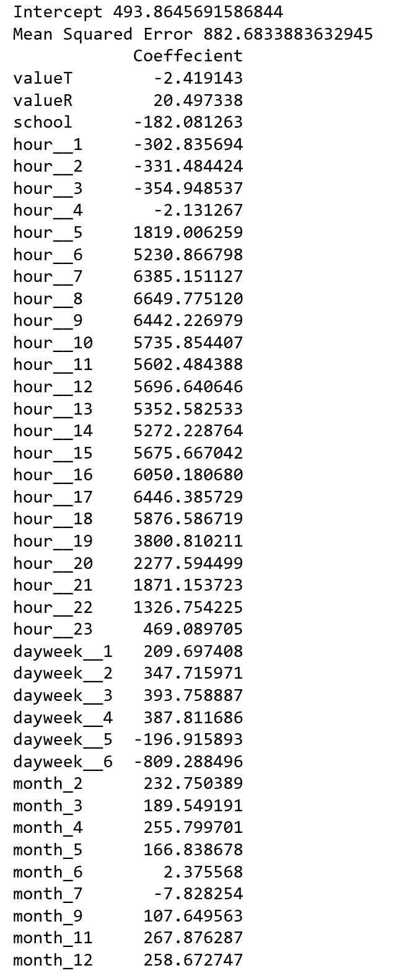
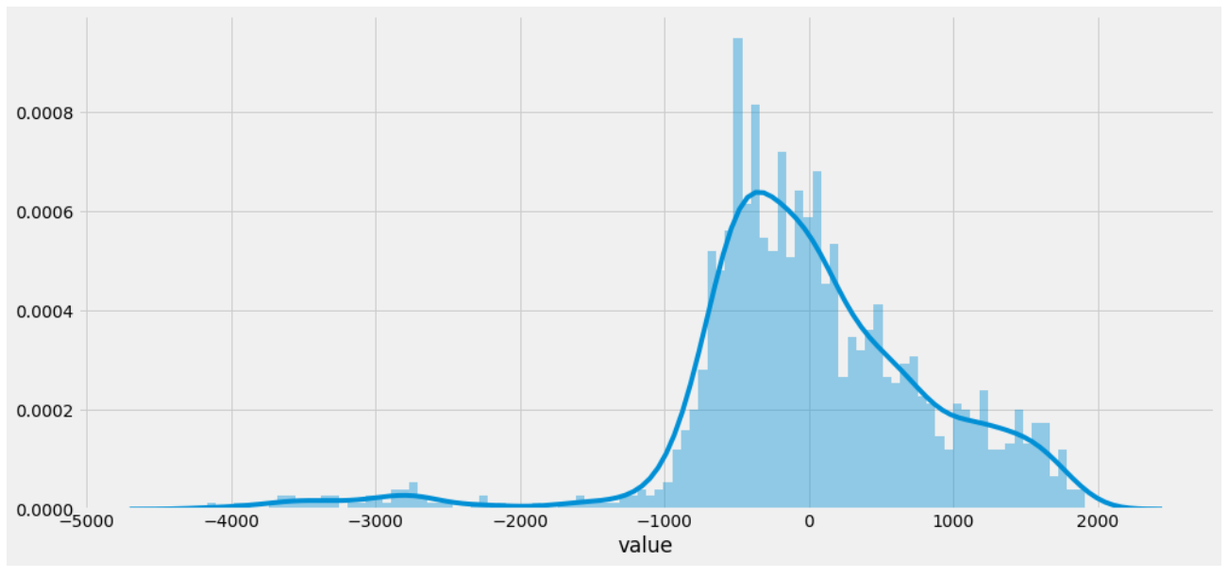
Converting the hours, days and months to categories somewhat normalised the distribution and lowered the MSE

Slide 10
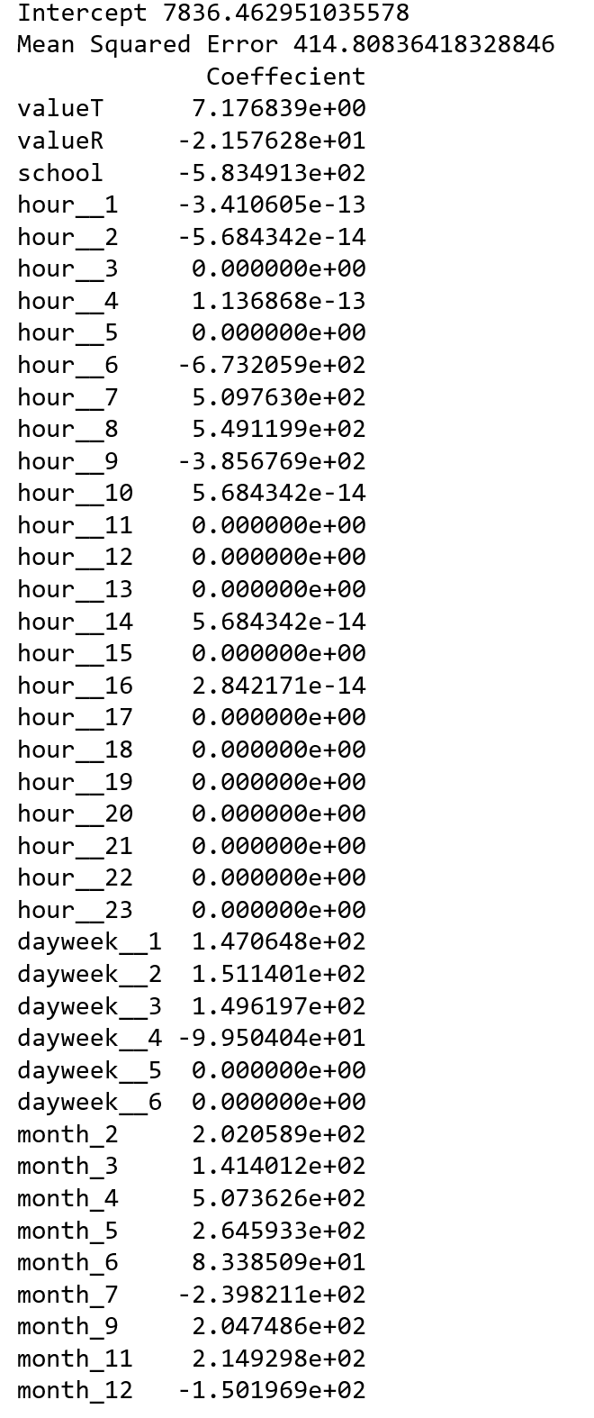
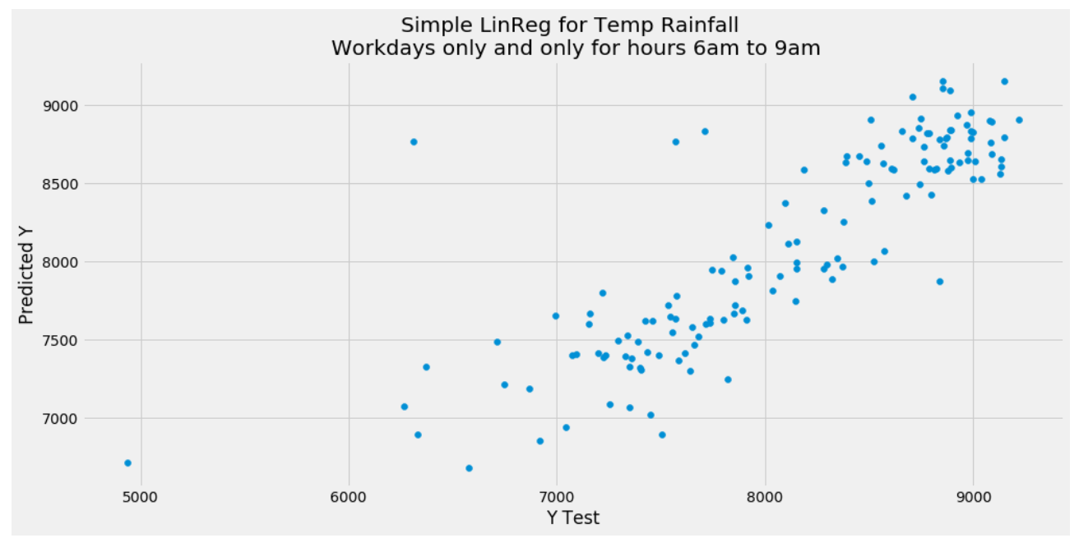
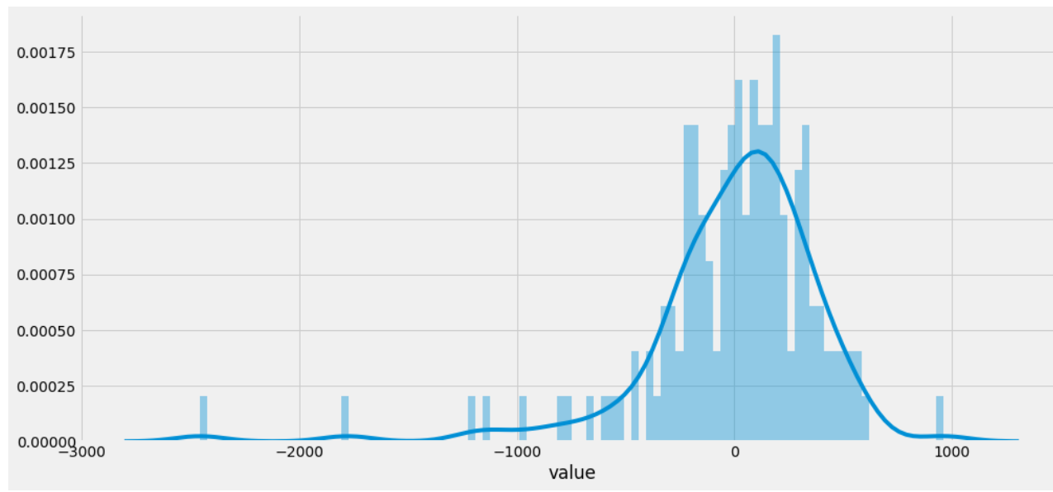
Being more selective about what to predict lowered the MSE further, and improved the residual histogram

Slide 11
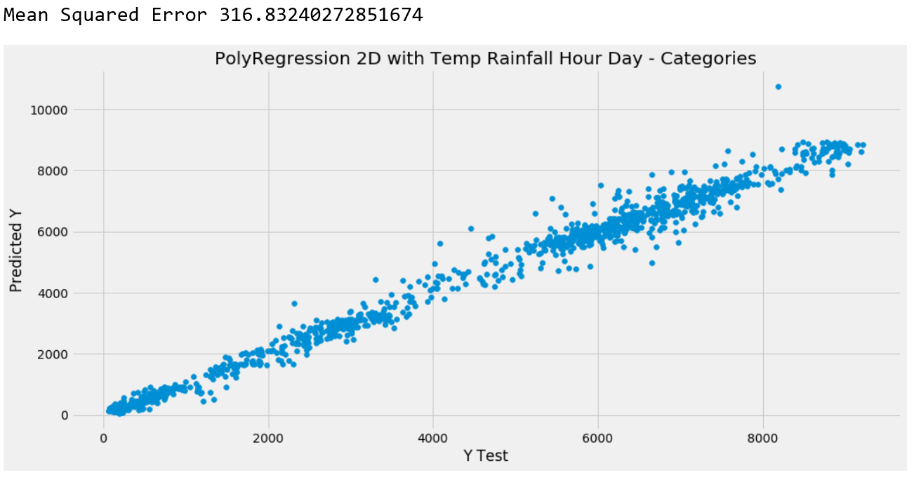
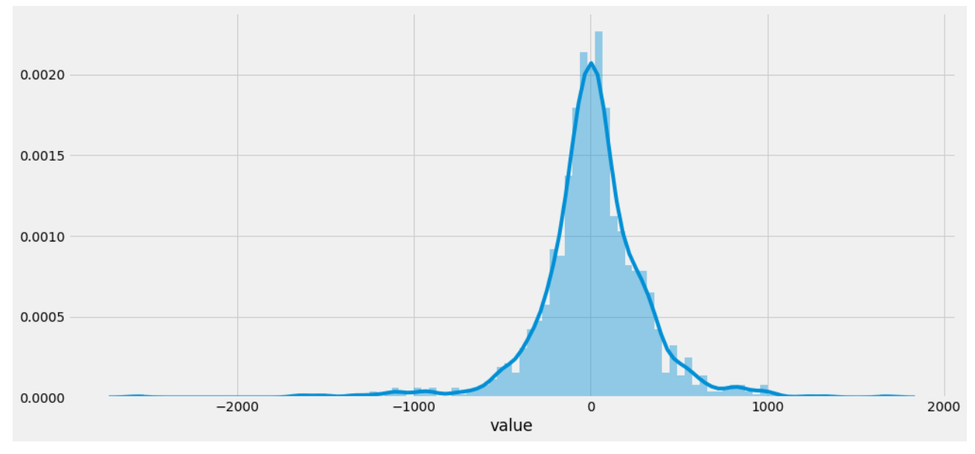
Experimenting with a polyfit enabled more accurate predictions over 24 hours.

Slide 12
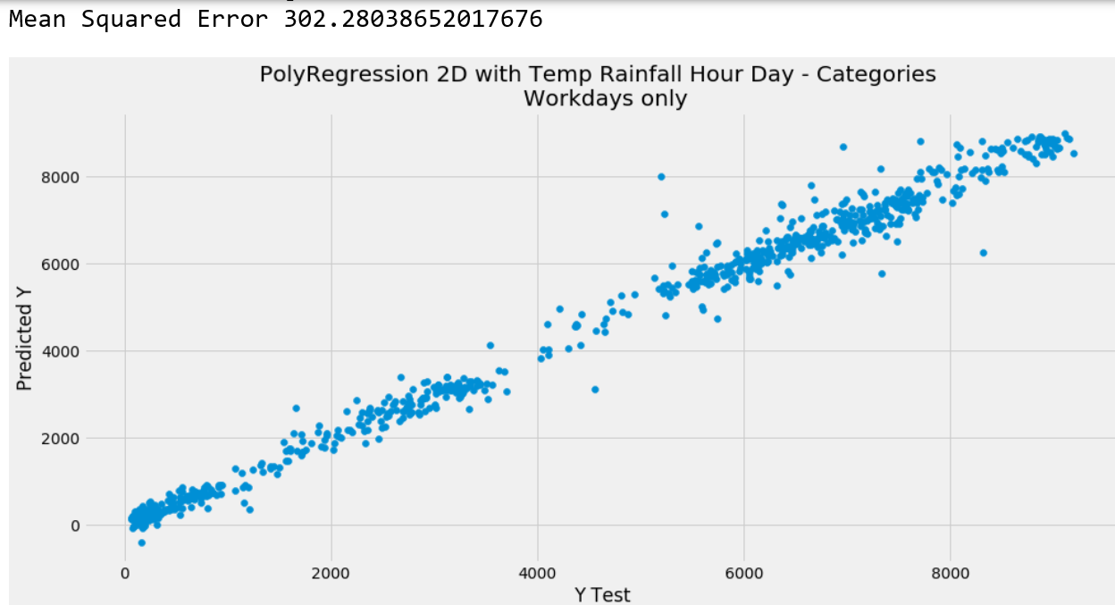
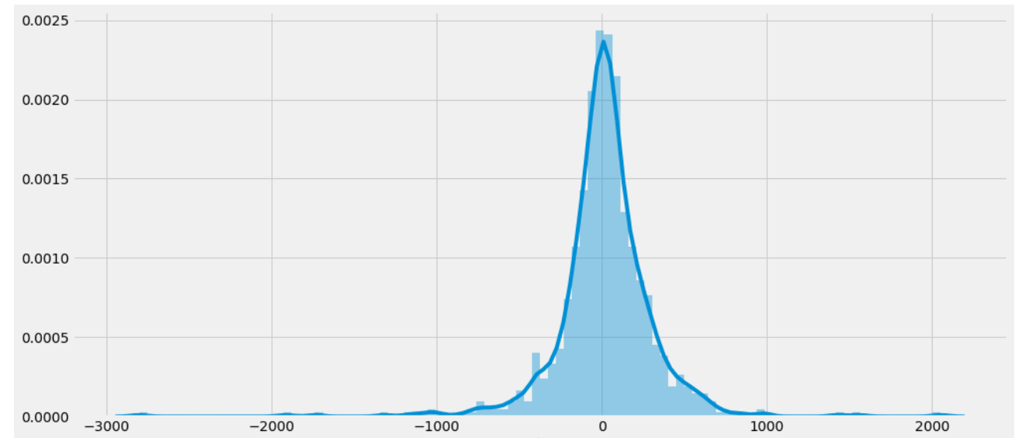
Another polyfit example with the lowest MSE of all models run.
This one was over 24 hours, but only on workdays.

